Slide 1

Supervised Seismic Section Classification with Convolutional Neural Networks (CNNs)
Zongpeng Chen
Supervisors: Olivier Dubrule, Lukas Mosser
Jeremy Fortun, Kurt Rattansingh

Slide 2
Introduction
General Introduction
Seismic Section
Objective
Workflow
Training and Results
Dataset
Test Section
Feed-Forward DNN Model and Result
Convolutional Neural Network (CNN) Models and Results
Final Ensemble Model and Result
Summary
After Training
Discussion
Conclusion
Q&A

Slide 3
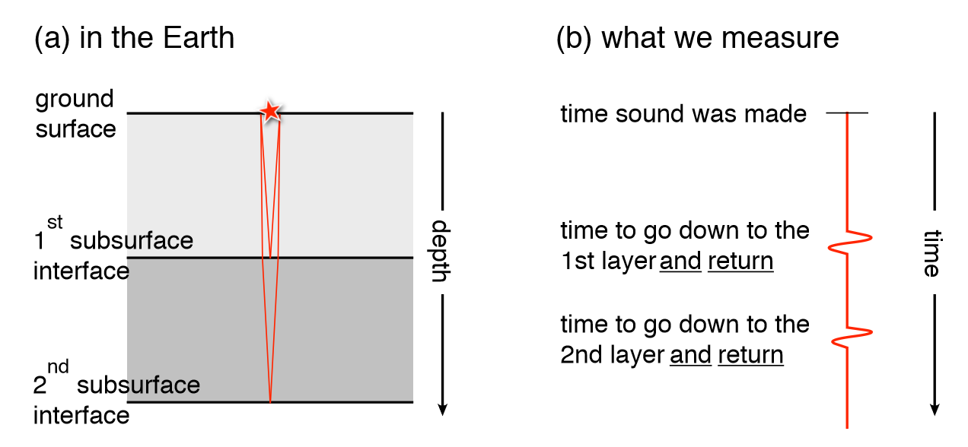

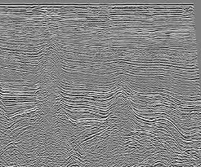
Seismic Section
(c) a lot of shots
(d) In large scale

Slide 4
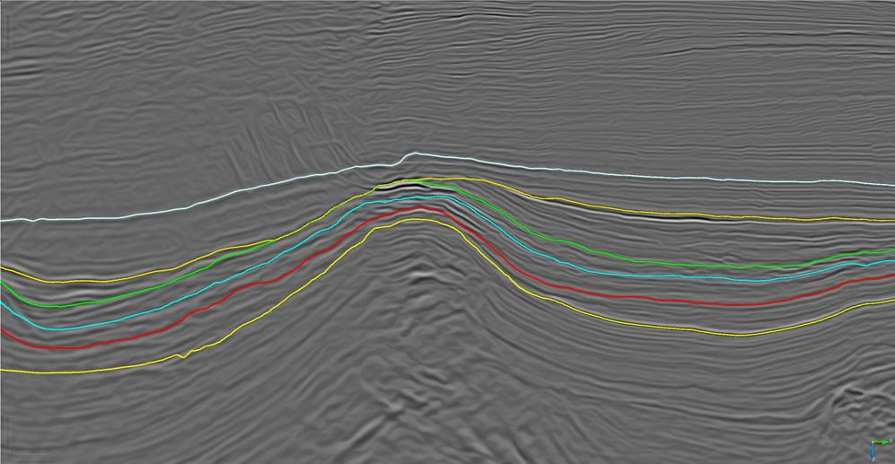
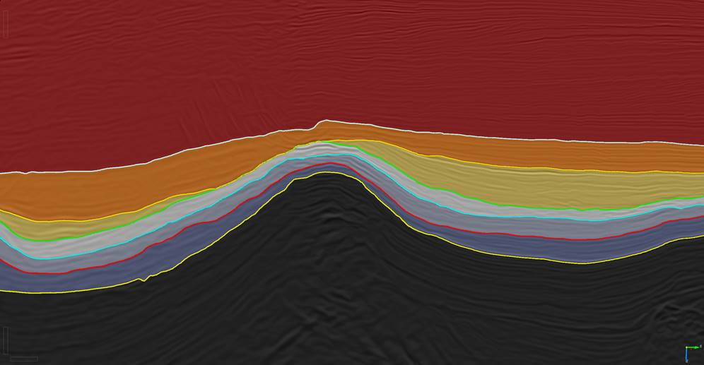
Supervised Seismic Section Classification with Convolutional Neural Networks
Objective
Unit 0
Unit 1
Unit 2
Unit 3
Unit 4
Unit 5
Unit 6
Test field in Gabon.
7 different units.

Slide 5
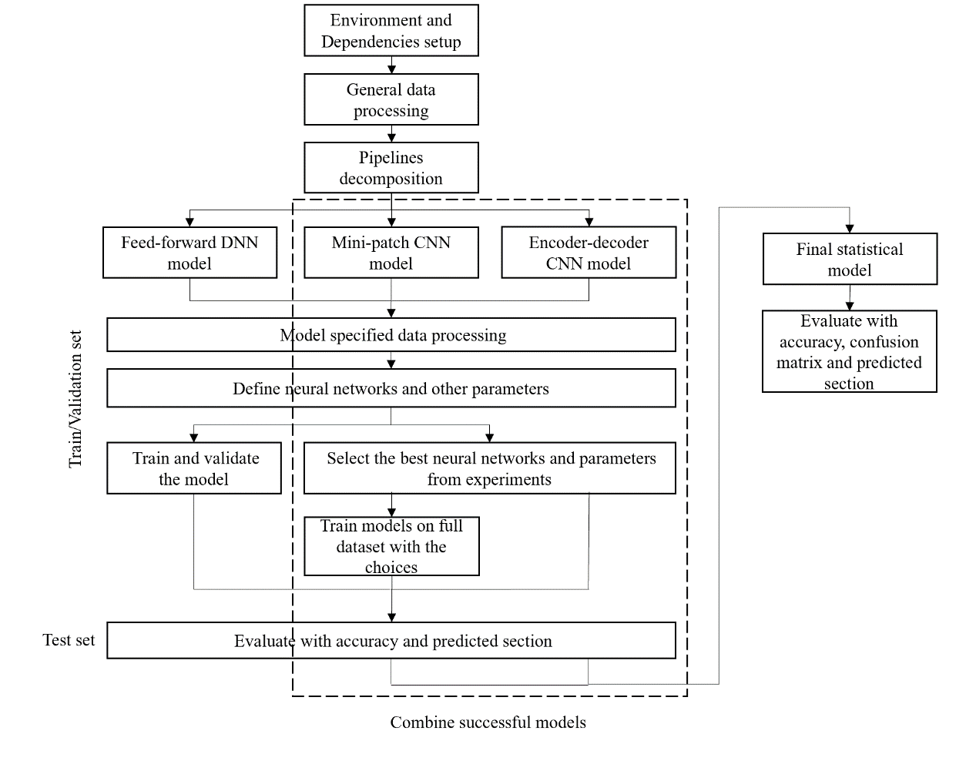
Workflow

Slide 6
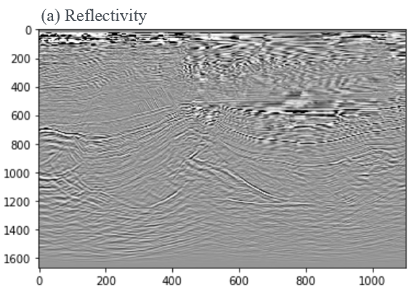
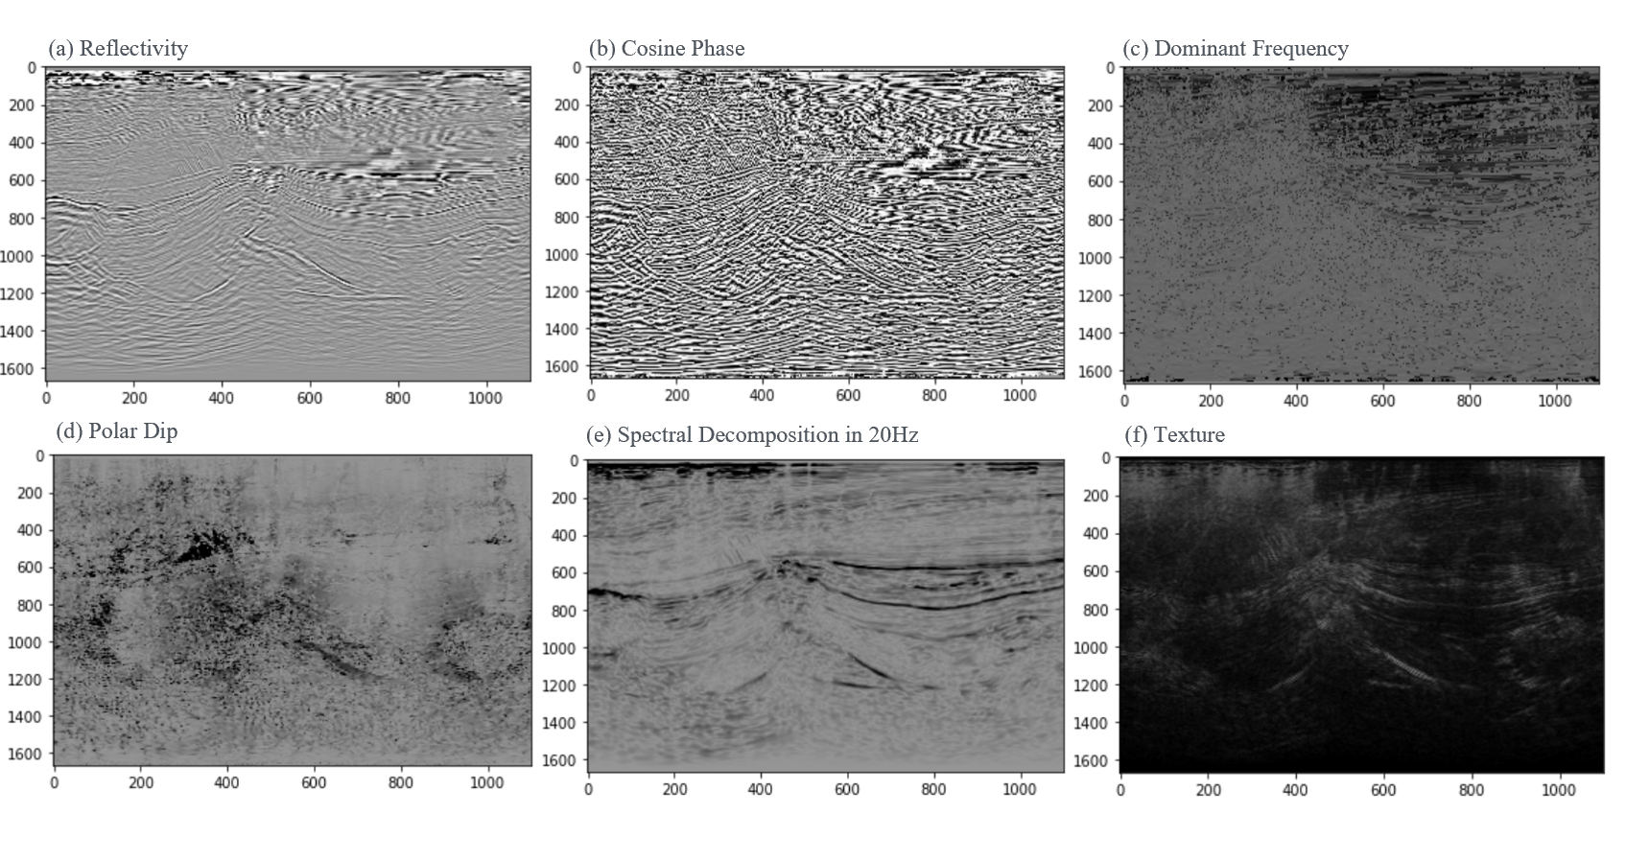
Dataset
5 interpreted Seismic sections are manually chosen to train the Machine (0.1% of total seismic dataset).
Split in 3: 1: 1 (3 Training sections, 1 Validation section and 1 Test section).
VS
‘1-feature’
‘6-feature’

Slide 7
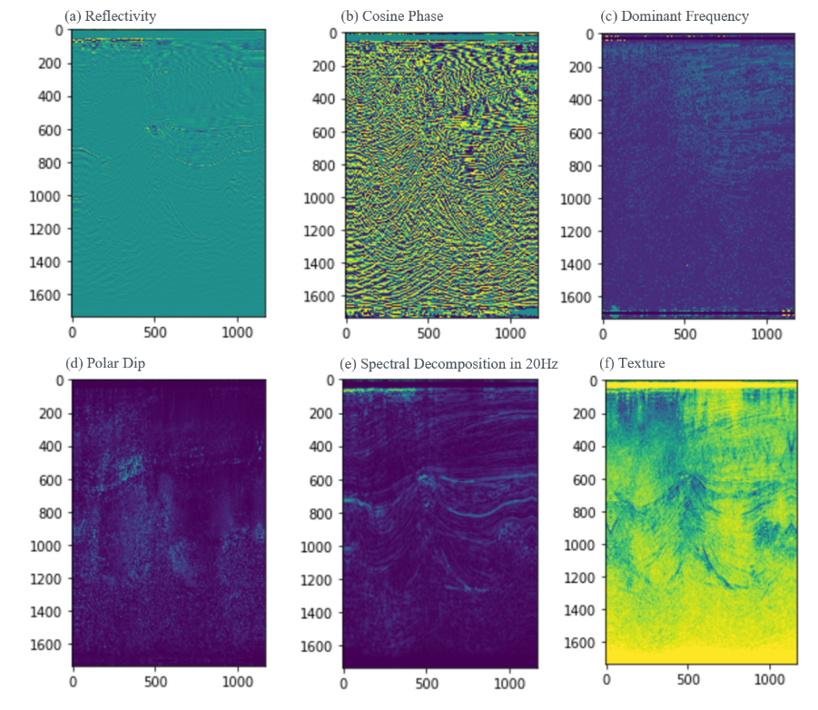
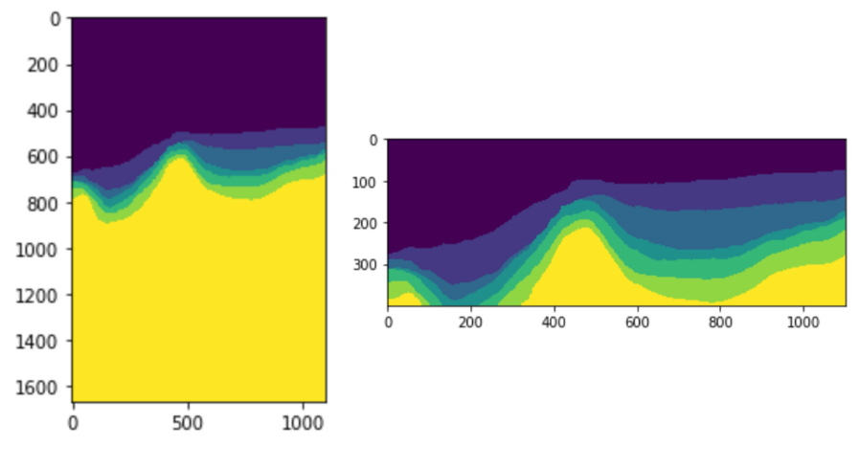
Test Section
Class label map

Slide 8
Feed-Forward DNN Model

Slide 9
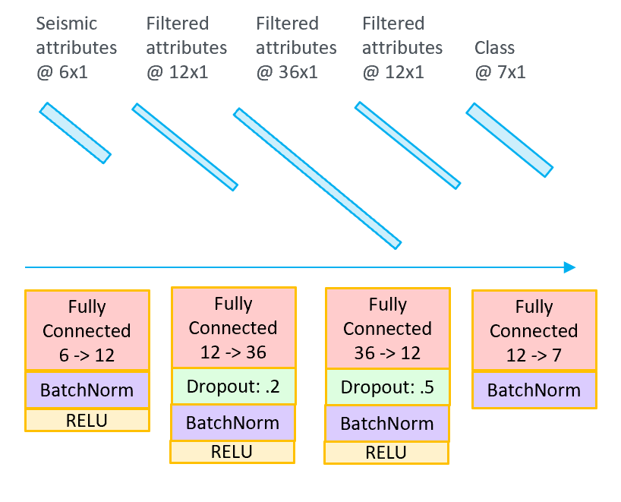
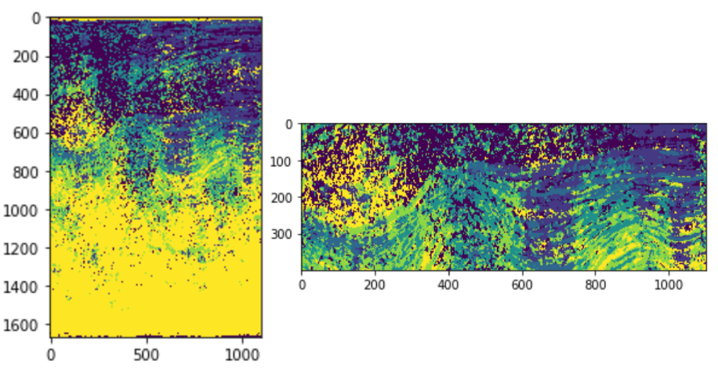
Feed-Forward DNN Model and Result
Human Interpretation
Network Architecture
Only on ‘6-feature’ dataset.
Bad accuracy and geological continuity.
Reference only.
Test Acc. ~9.0%

Slide 10
Mini-patch CNN Model

Slide 11
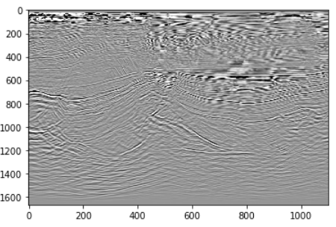
Convolutional Neural Network (CNN) Models and Results
Mini-patch CNN Model
1st pixel
65
2nd pixel
65
…
1667
1667 x 1101 training squares in each seismic section
1101

Slide 12
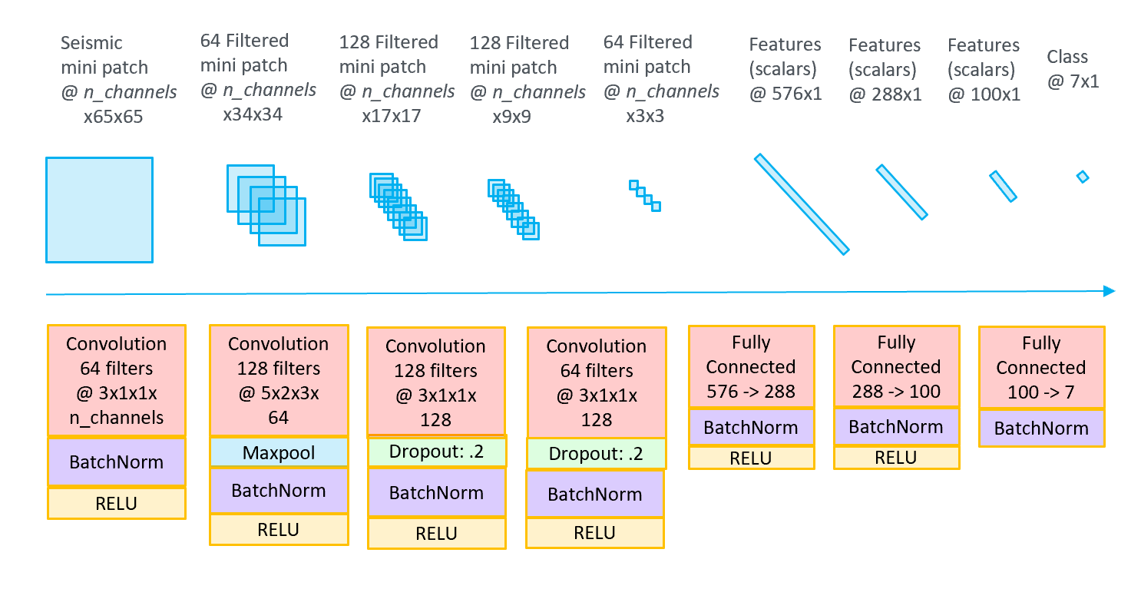
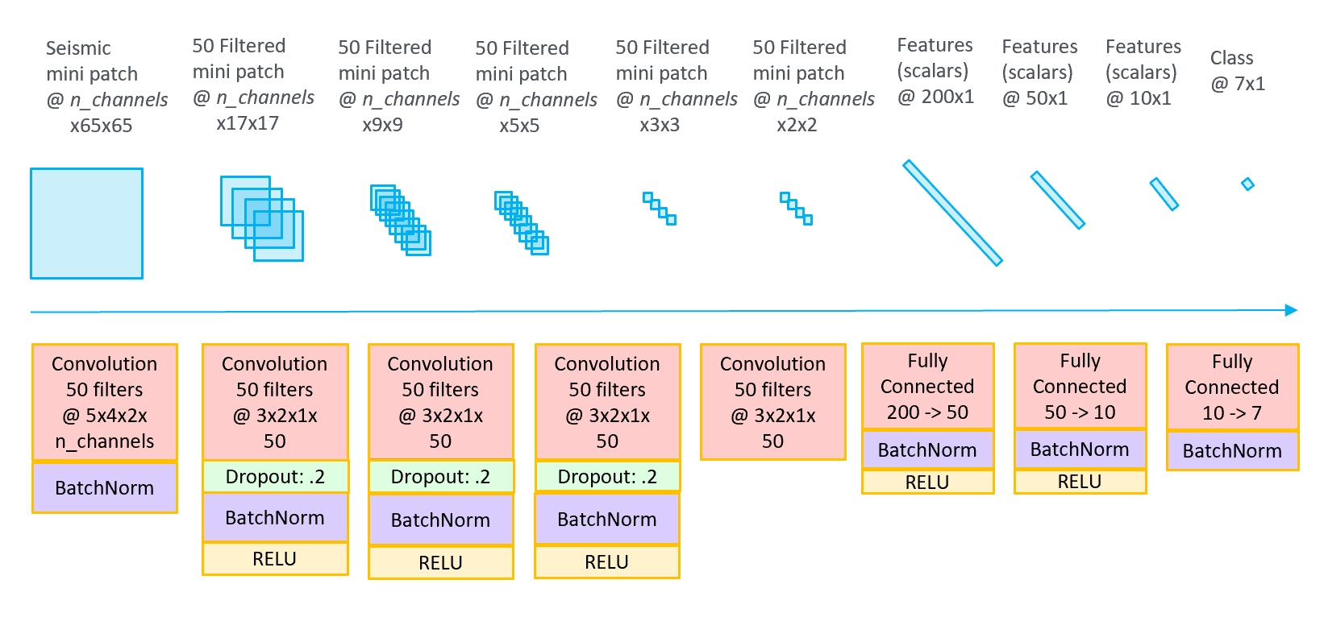
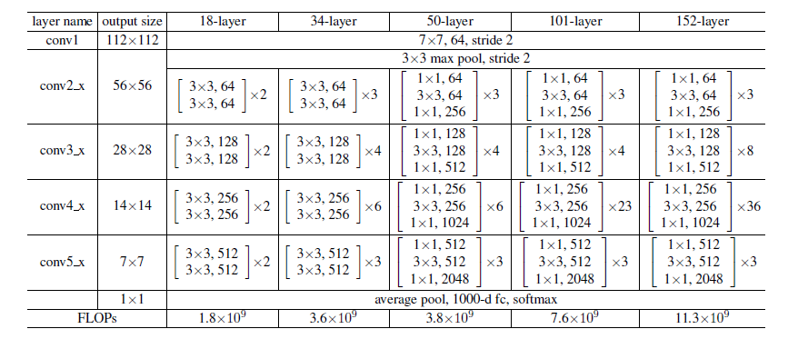
Convolutional Neural Network (CNN) Models and Results
Mini-patch CNN Model
Network Architectures
OptimizedNet
BasicNet
ResNet

Slide 13
Convolutional Neural Network (CNN) Models and Results
Mini-patch CNN Model
Training VS Validation
On ‘1-feature’ dataset:
Learning rate
 | 2*10⁻² |  | 1*10⁻² |  | 5*10⁻³ |  | 1*10⁻³
 | Training | Validation | Training | Validation | Training | Validation | Training | Validation
BasicNet | 88.9% | 88.6% | 91.1% | 88.3% | 92.0% | 89.8% | 92.5% | 89.9%
OptimizedNet | 97.6% | 92.3% | 98.4% | 92.4% | 98.8% | 92.4% | 99.0% | 92.4%
ResNet 18 | 98.7% | 91.6% | 99.3% | 91.1% | 99.5% | 91.0% | 99.7% | 91.3%
ResNet 34 | 98.6% | 91.8% | 99.3% | 91.9% | 99.5% | 91.6% | 99.7% | 91.7%
ResNet 50 | 98.3% | 90.8% | 99,1% | 90.4% | 99.4% | 90.5% | 99.7% | 90.8%
Neural Network
On ‘6-feature’ dataset:
Learning rate
 | 2*10⁻² |  | 1*10⁻² |  | 5*10⁻³ |  | 1*10⁻³
 | Training | Validation | Training | Validation | Training | Validation | Training | Validation
BasicNet | 88.5% | 90.5% | 90.9% | 90.9% | 92.0% | 91.2% | 92.5% | 91.1%
OptimizedNet | 97.1% | 92.4% | 98.2% | 92.8% | 98.6% | 93.1% | 98.8% | 93.0%
ResNet 18 | 98.4% | 92.2% | 99.2% | 92.0% | 99.5% | 92.2% | 99.7% | 92.5%
ResNet 34 | 98.2% | 92.2% | 99.1% | 92.1% | 99.5% | 92.1% | 99.7% | 92.3%
ResNet 50 | 98.1% | 91.8% | 99.1% | 91.8% | 99.5% | 92.0% | 99.7% | 92.0%
Neural Network

Slide 14
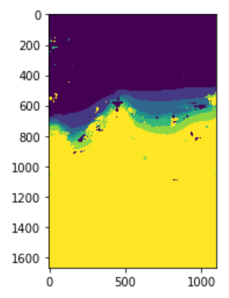
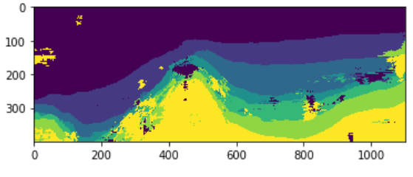
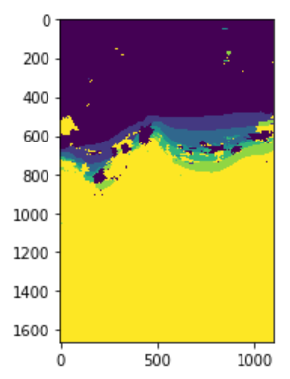
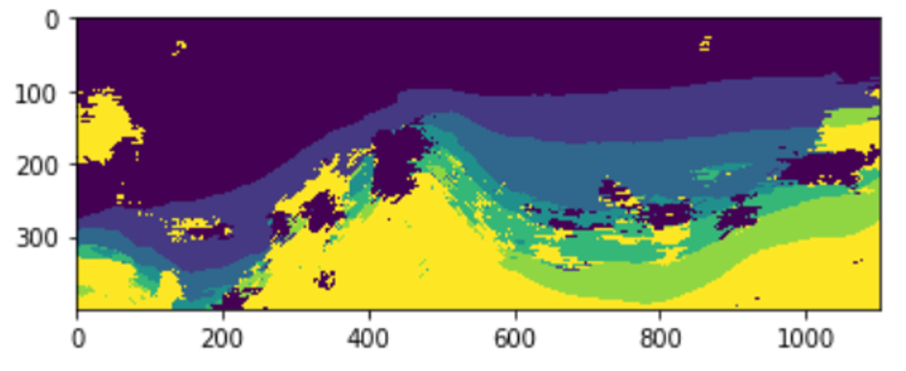
Convolutional Neural Network (CNN) Models and Results
Mini-patch CNN Model
OptimizedNet
Full dataset training
on ‘1-feature’ dataset
Human Interpretation
Test Acc. ~96.9%
ResNet 34
Good accuracy but low geological continuity.
Test Acc. ~95.2%

Slide 15
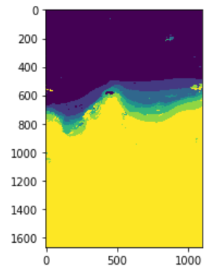
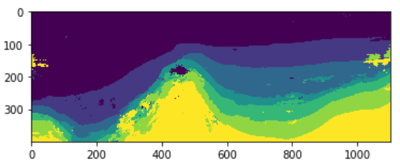
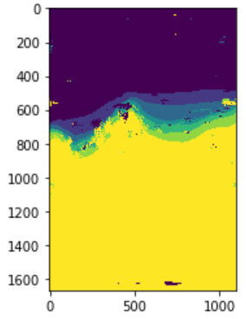
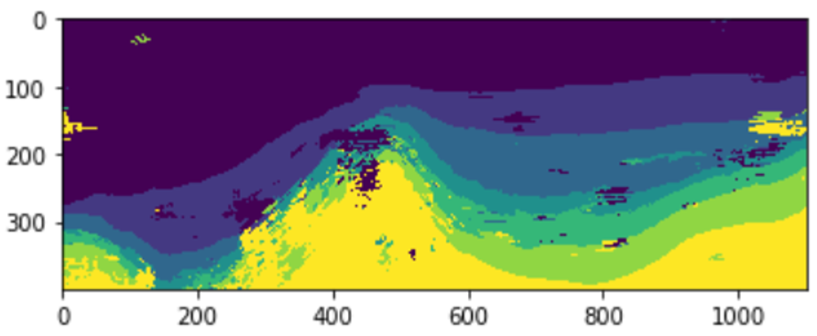
Convolutional Neural Network (CNN) Models and Results
Mini-patch CNN Model
OptimizedNet
Full dataset training
on ‘6-feature’ dataset
Human Interpretation
Test Acc. ~97.7%
ResNet 34
Better accuracy and better geological continuity.
Test Acc. ~96.7%

Slide 16
Encoder-decoder CNN Model

Slide 17
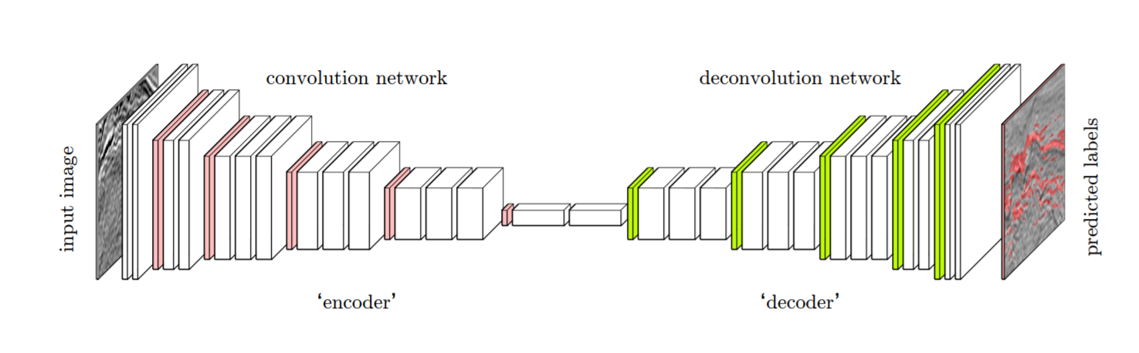
Convolutional Neural Network (CNN) Models and Results
Encoder-decoder CNN Model
Whole image as a training object
Use ‘encoder’ to extract features and classify different facies
Use ‘decoder’ to accurately localize the different facies

Slide 18
Convolutional Neural Network (CNN) Models and Results
Encoder-decoder CNN Model
1667
1536
1024
1101
1 training squares in each seismic section

Slide 19
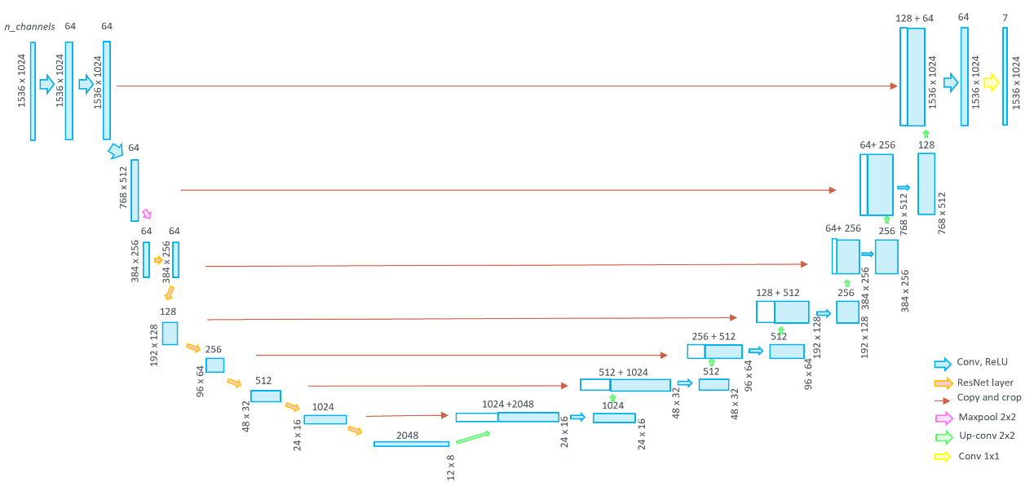
Convolutional Neural Network (CNN) Models and Results
Encoder-decoder CNN Model
Network Architecture
Encoder
Decoder
ResNetUNet

Slide 20
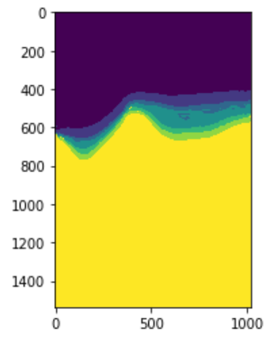
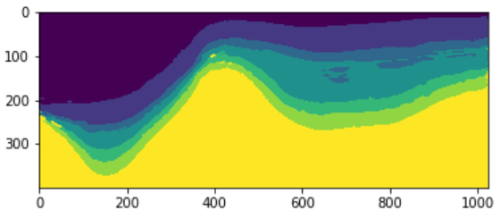
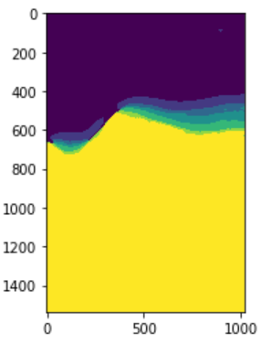
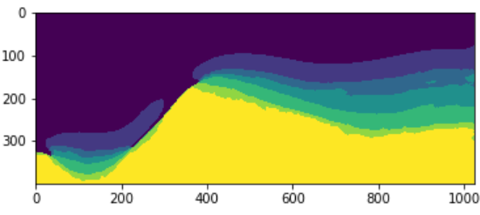
Convolutional Neural Network (CNN) Models and Results
Encoder-decoder CNN Model
‘1-feature’ dataset
Human Interpretation
Test Acc. ~88.9%
‘6-feature’ dataset
Good Geological continuity but low accuracy.
Hard to converge with a small number of datasets.
‘6-feature’ still wins on accuracy.
Test Acc. ~89.0%

Slide 21
Final Ensemble Model

Slide 22
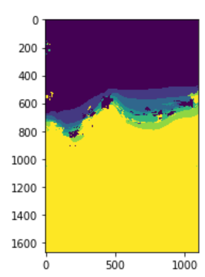
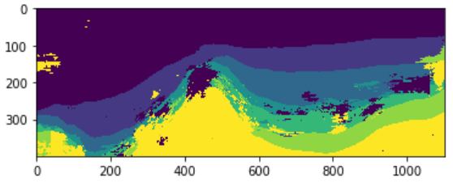
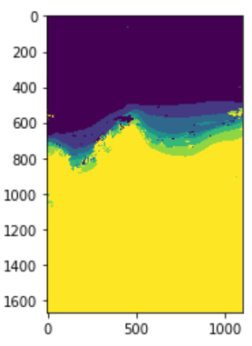
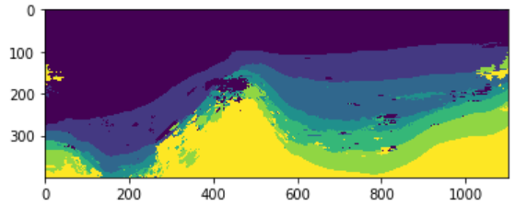
Final Ensemble Model and Result
Final Ensemble Model
‘1-feature’ dataset
Human Interpretation
Test Acc. ~96.3%
‘6-feature’ dataset
No Training.
Combine the CNN models.
Combine strengths partly but not good enough .
Test Acc. ~97.3%

Slide 23
Summary
On ‘1-feature’ dataset
 | Training | Test
Feed-forward DNN model | N/A | N/A
Mini-patch CNN model (OptimizedNet) | 99.4% | 96.9%
Mini-patch CNN model (ResNet 34) | 99.7% | 95.2%
Encoder-decoder model | N/A | 88.9%
Final ensemble model | N/A | 96.3%
On ‘6-feature’ dataset
 | Training | Test
Feed-forward DNN model | 35.2% | 9.0%
Mini-patch CNN model (OptimizedNet) | 99.3% | 97.7%
Mini-patch CNN model (ResNet 34) | 99.6% | 96.7%
Encoder-decoder model | N/A | 89.0%
Final ensemble model | N/A | 97.3%

Slide 24
After Training
Discussion
Misclassified pixels:
Data Quality
Geological Complexity
Neural Network Design
Final Ensemble Model has lower accuracy than some of its member models:
Number of member models
Quality of member models

Slide 25
After Training
Conclusion
High accuracy and geological continuity achieved.
‘6-feature’ > ‘1-feature’.
Better score could certainly be achieved

Slide 26
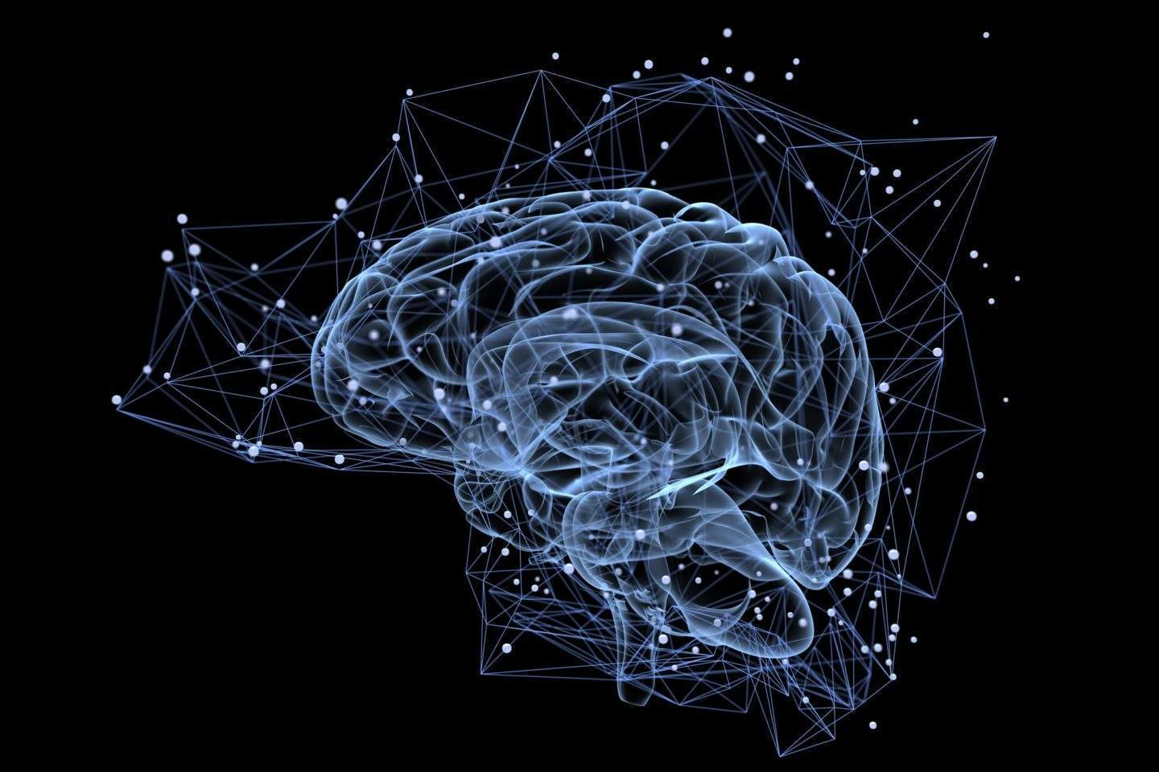
Thanks !

